Slide 1

Website Makeover Project
Saving the world from
horrible websites
By Mark Spencer Tan

Slide 2
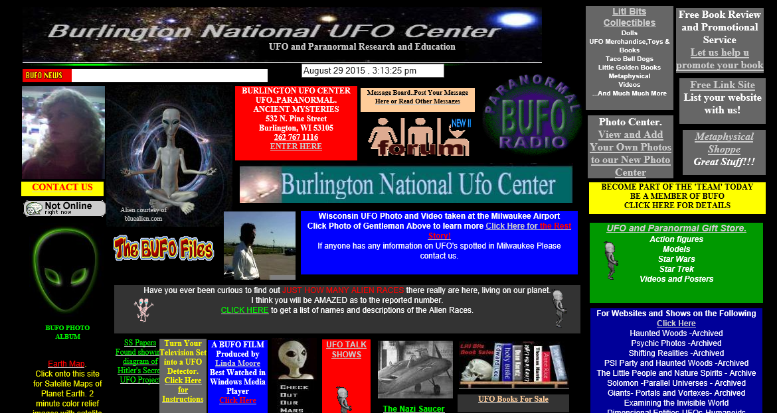
Burlington National UFO Center
URL:
http://www.burlingtonnews.net/burlington_ufo_center.html
Topic:
Provides information about extraterrestrial life
Informs people about local UFO sightings and Alien news

Slide 3
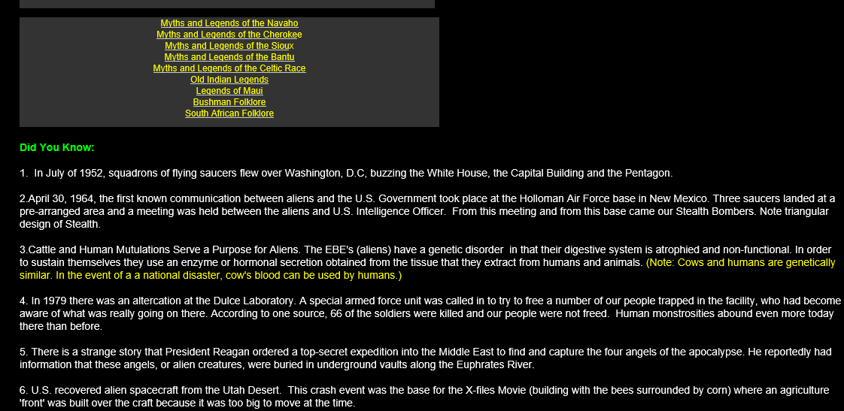
Does the website address the topic properly?
Has plenty of facts about Aliens and UFOs
Facts and links are disorganized
Hard to navigate through information
Has too many links about her Live Radio Broadcast and books
Too much advertisements and images

Slide 4

Audience
People that are interested about Aliens and UFOs
Aliens that wants to know more about what humans think of them

Slide 5
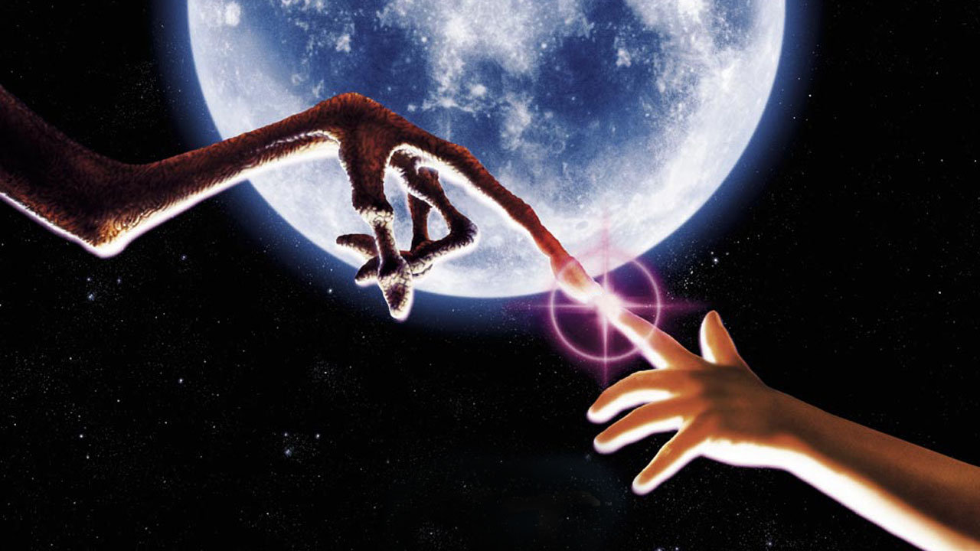
Accessibility
Missing Alt texts on images
Layout must be simplified for better adaptability
Many content not compatible with accessibility programs.
Hard to read/translate

Slide 6
Should The Site Be Divided?
YES

Slide 7
Pages
Home
Recent UFO and Alien Sightings
Report a sighting
Facts
Shop

Slide 8
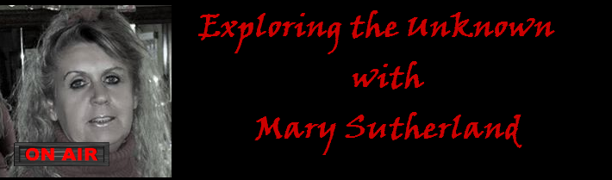
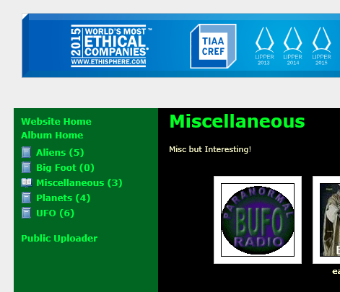
What Works?
Shop
Live Radio Broadcasts (Find your alien on the go)
Links
Photo Center
Search Bar

Slide 9




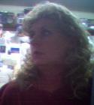

What to add/remove
ADD:
Nav Panel
Better Logo
REMOVE:
Unnecessary images (Selfies and Alien GIFs)
Remove unrelated links on the main page
Decrease content on the main page

Slide 10
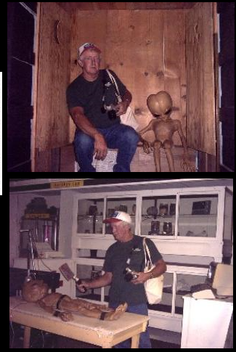
Disturbing Images

Slide 11
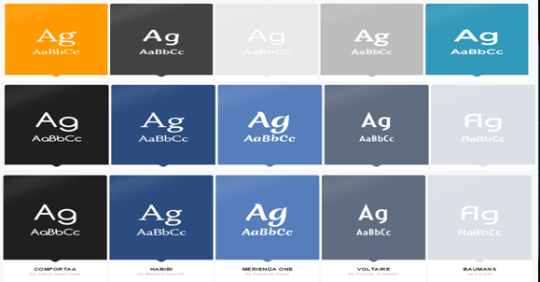
Color Schemes

Slide 12
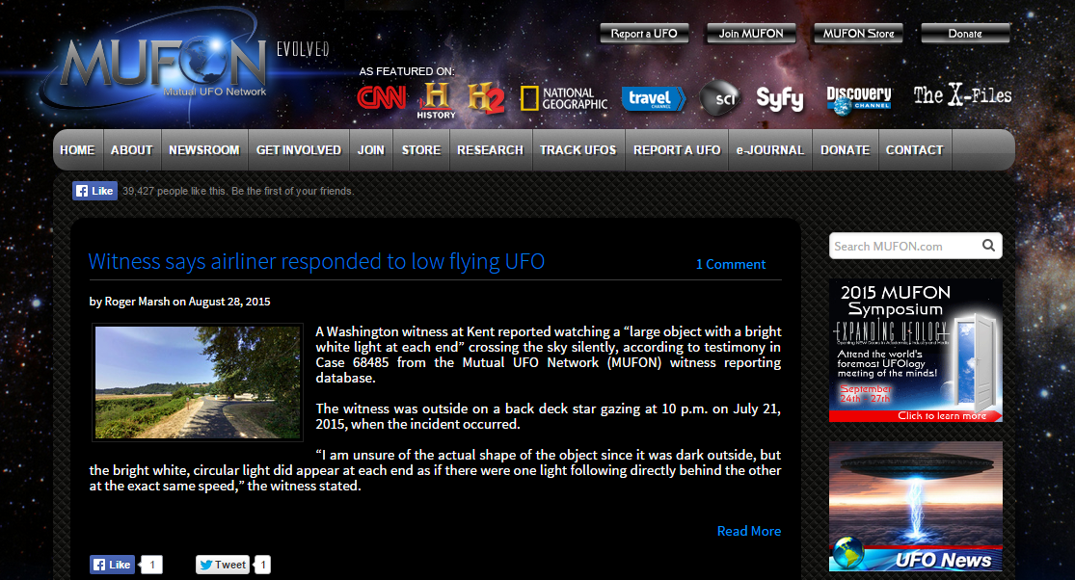
Mufon
http://www.mufon.com/ufo-news

Slide 13
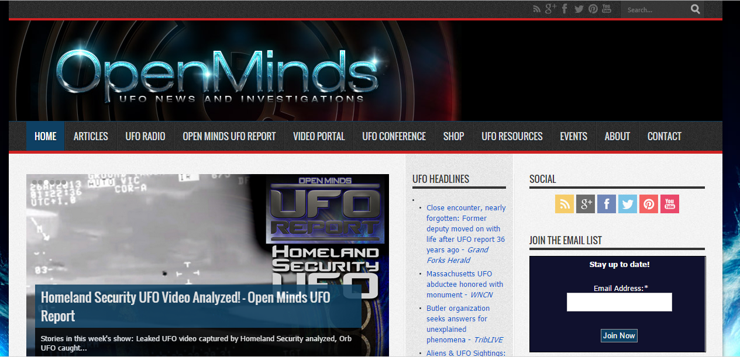
Openmind
http://www.openminds.tv/

